Slide 1
Application of Machine Learning To Epileptic Seizure Detection
Ohoud Rehbini , PhD
General Assembly and Misk Academy

Slide 2
Outline :
Problem statement
Data source (how many datasets you have - format - dataset description)
Data preprocessing ( cleaning - feature engineering - joining datasets)
Solution structure (models type - features used - models scores- EDA )
Live demo or prediction sample
Challenges
Future work or next steps

Slide 3
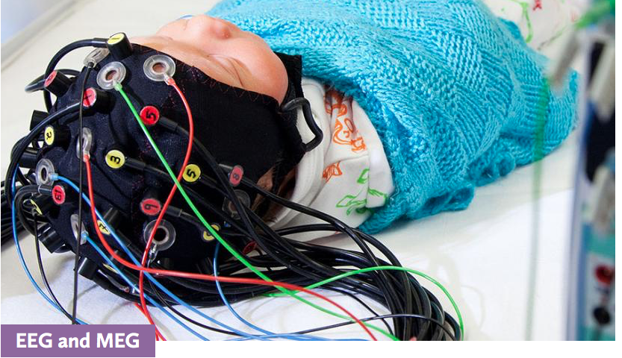
Seizures are symptoms of a brain problem. They happen because of sudden, abnormal electrical activity in the brain.

Slide 4
Introduction
The difference between MEG and EEG ?
- Electro-encephalography (EEG) and magneto-encephalography (MEG) are functional imaging methods used to measure brain activity directly and non-invasively (from outside the head).
- EEG detects synchronised electrical activity of large groups of neurons, whereas MEG detects the tiny changes in magnetic fields that this electrical activity is associated with.
- The images produced by EEG and MEG are not very localised, but they can monitor how electrical activity changes with time very precisely.
- EEG requires electrodes to be attached to the scalp. It can be used to detect general patterns of electrical activity, such as the brain waves that occur during sleep.
- Researchers used EEG to compare the visual cortex activity of people who are born blind with those who are not blind, and they found that the visual cortex of blind people was active.
- EEG can also be used to detect electrical signals associated with specific sensory stimuli, thought processes or movements.

Slide 5
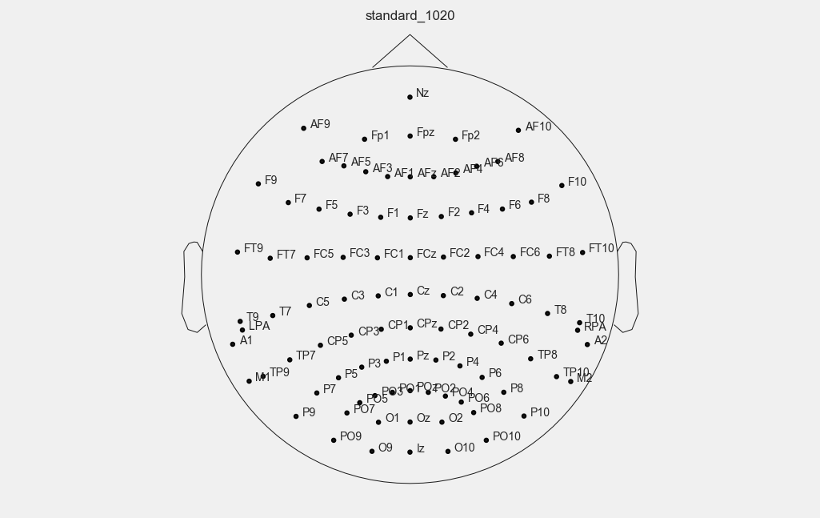
what is 10-20 system ?
1. is an internationally reconized method that allow eeg electrode placement to be standardised.
2. ensure that inter-electrode is sapcing is equal
3. electrode placements proportional to skull size and shape
4. covers all brain regions F = Frontal , P = Parietal , T = Temporal , O = Occipital
5. numbering system: Odd = left side , Even = right side, Z = midline
6. it has 23 channel
what is montage ?
each EEG trace is generated from an active and a reference electrode. different patterns of electrodes are selected and the traces goruped to provide data from different areas of the scalp.

Slide 6
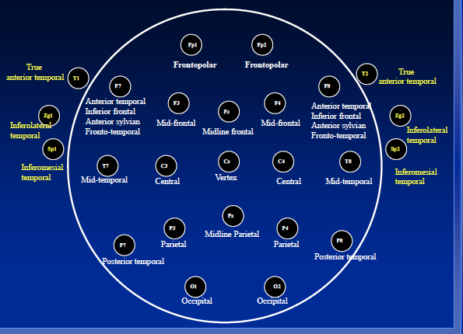

Slide 7
Problem statement
machine learning approach to constructing patient-specific classifiers that detect the onset of an epileptic seizure through analysis of the scalp EEG, a non-invasive measure of the brain’s electrical activity.
This problem is challenging because the brain’s electrical activity is composed of numerous classes with overlapping characteristics. The key steps involved in realizing a high performance algorithm included shaping the problem into an appropriate machine learning framework, and identifying the features critical to separating seizure from other types of brain activity.

Slide 8
Data source (how many datasets you have - format - dataset description)
The data is a big data were collected from MIT (CHB-MIT) public database.
The big data contains 23 cases (5 males and 17 females). Each cases contains one folder that has one seizures and/or more seizures detected. Some folders were collected in 1 hr others in 4 hrs long whereas other cases were collected in 2 hrs. 256 signals per second were recorded.
There are other signals were included in the data (considered as noise) such as ECG and VNS. The recored were saved in Europe data format (edf). The edf file contained 664 records and 182 signals were recorded as seizures in the total 23 cases.
However, in case of this study one cases (chb03) that has high recorded seizure activities and it was used to perform the algorithum to detect seizures and provide solution and future work for next step.

Slide 9
sample informaiton:
chb03-01
File Name: chb03_01.edf
File Start Time: 13:23:36
File End Time: 14:23:36
Number of Seizures in File: 1
Seizure Start Time: 362 seconds
Seizure End Time: 414 seconds
Channels in EDF Files:
**********************
- Channel 1: FP1-F7
- Channel 2: F7-T7
- Channel 3: T7-P7
- Channel 4: P7-O1
- Channel 5: FP1-F3
- Channel 6: F3-C3
- Channel 7: C3-P3
- Channel 8: P3-O1
- Channel 9: FP2-F4
- Channel 10: F4-C4
- Channel 11: C4-P4
- Channel 12: P4-O2
- Channel 13: FP2-F8
- Channel 14: F8-T8
- Channel 15: T8-P8
- Channel 16: P8-O2
- Channel 17: FZ-CZ
- Channel 18: CZ-PZ
- Channel 19: P7-T7
- Channel 20: T7-FT9
- Channel 21: FT9-FT10
- Channel 22: FT10-T8
- Channel 23: T8-P8

Slide 10
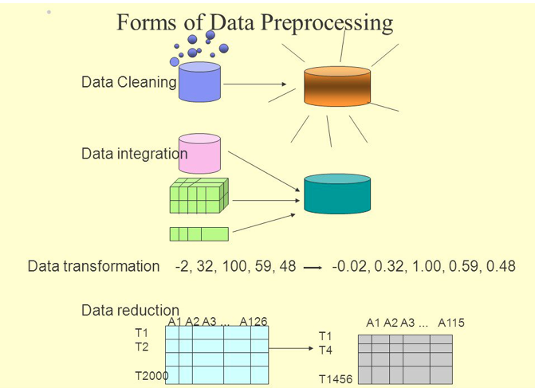
Data preprocessing ( cleaning - feature engineering - joining datasets)

Slide 11
Solution structure (models type - features used - models scores- EDA )
Big data (>2,000,000 from 23 cases )
.edf file and read the file from MNE library in python 3.7
.edf file convert to csv file in python 2.7 then to python 3.7
We use model called ICA , Braindecode library
Modeling , feature engineering, visualization
MNE is a Python package for EEG/MEG processing. It offers a wide variety of useful tools including input/output, filtering, independent component analysis (ICA), forward modeling, inverse solutions, time-frequency decompositions, visualization, and more. EEG data was loaded from MIT database, now i will view and edit associated meta information.

Slide 12
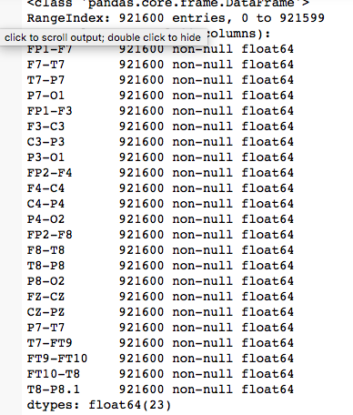
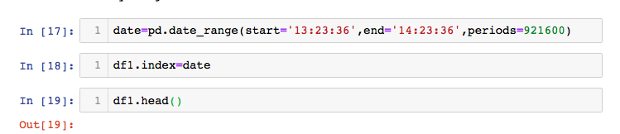
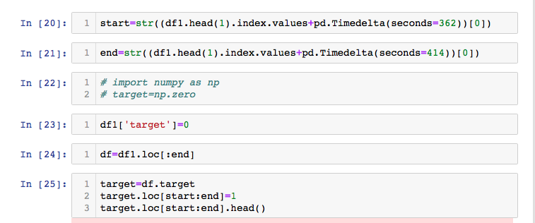

Slide 13
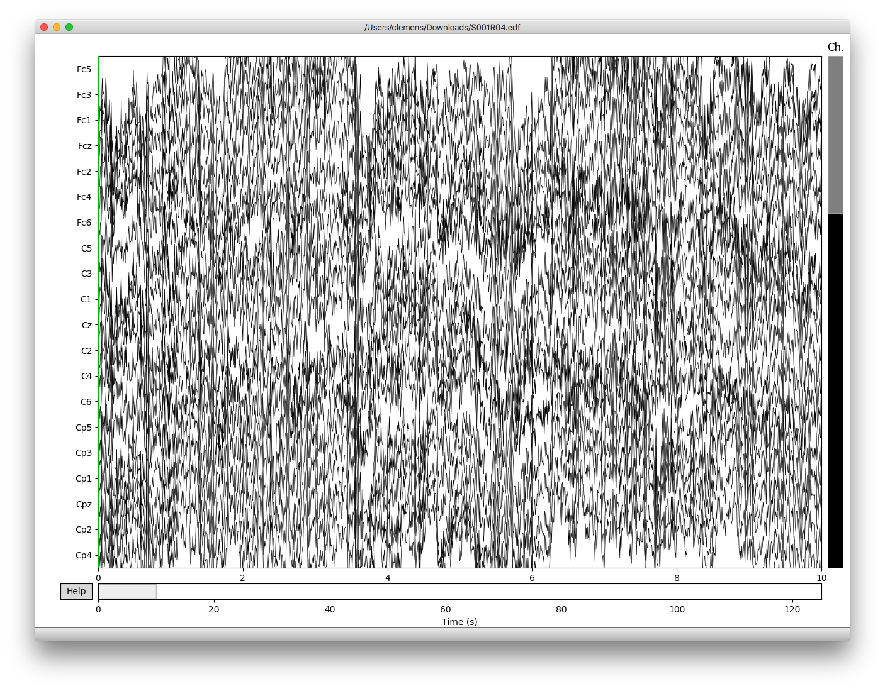
Interactive visualization
rescale the signals with the + and – keys. The default scaling is not really appropriate here, but pressing the – key a few times will result in a much nicer display.

Slide 14
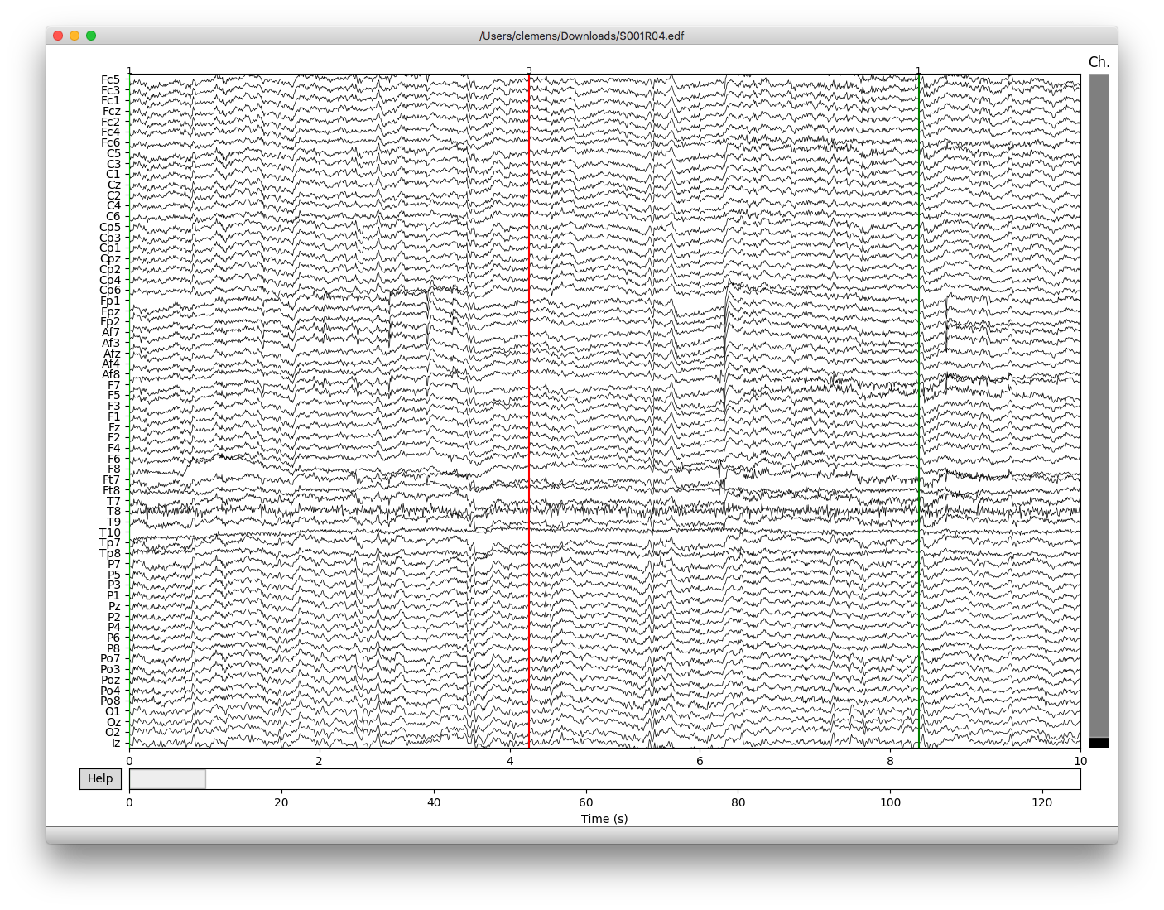

Slide 15
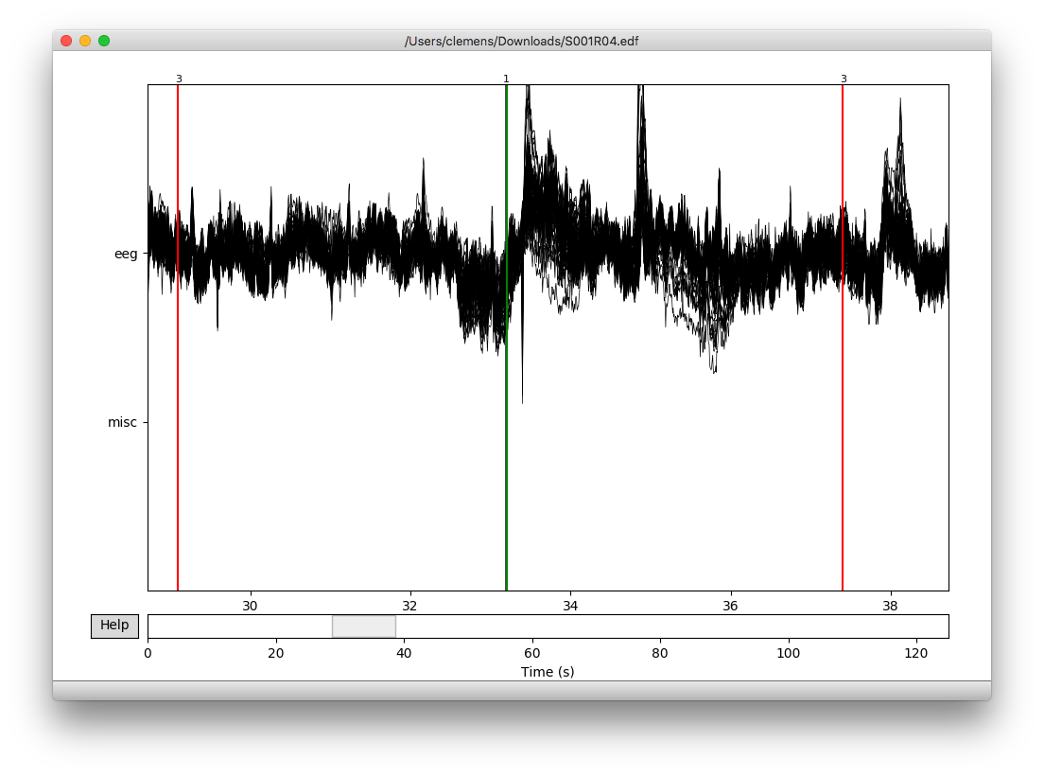

Slide 16
Model | Scores
Logistic Regression | 60.85%
Random Forest Classifier | 1.0%
SVC | 99.3%
Linear SVC | 53.4%
K neighbors Classifier | 98.79%
GaussianNB | 97.95%
PCA | 18.0%

Slide 17
Challenges
Big data >2,000,000
PC limitation
The use of .edf need more space to work.
Annotate the seizures in the map
Select the right model and predict whether if there is seizure or not .

Slide 18
Future work or next steps
Use powerful PC
Annotation problems
Use CNN
Use ICA in python

Slide 19

Acknowledgment …
Esraa Madi
Khalid
Mohammed Hakami
Rand Al-Arrage
Spenser
I want to give speical thank to ..
Abdullah Al-Ghamdi
Thank you for MISK scholarship
And general Assembly for accepting me in this course.

